Slide 1

Azure Function App

Slide 2
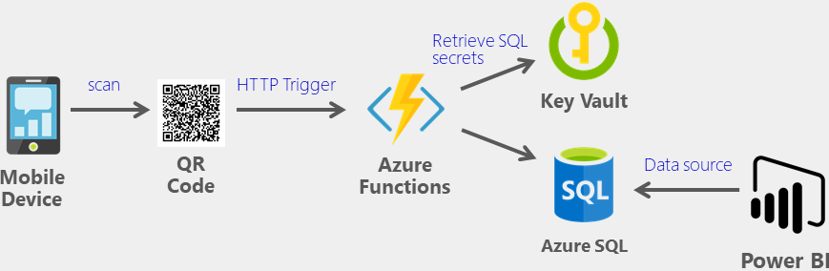
What are Function Apps and its usage
Can author and execute snippets of code in the cloud
No hassle of managing the servers
It lets you run small pieces of code
Doesn’t have to worry about the infrastructure of the platform
Notes:
https://microsoft-bitools.blogspot.com/2020/02/use-azure-key-vault-for-azure-data.html

Slide 3
Azure Function App: Hands-on
Create our first Function App

Slide 4
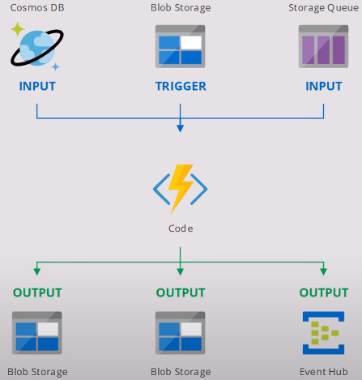
How Azure Functions Works

Slide 5
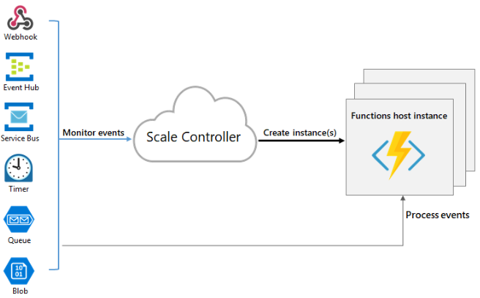
Scale up and Scale Down

Slide 6
Pricing
Consumption plan is billed based on per-second resource consumption and executions
For more details, please refer:
https://azure.microsoft.com/en-in/pricing/details/functions/

Slide 7
Azure Function: Hands-on
Create a Function in Azure Function App

Slide 8
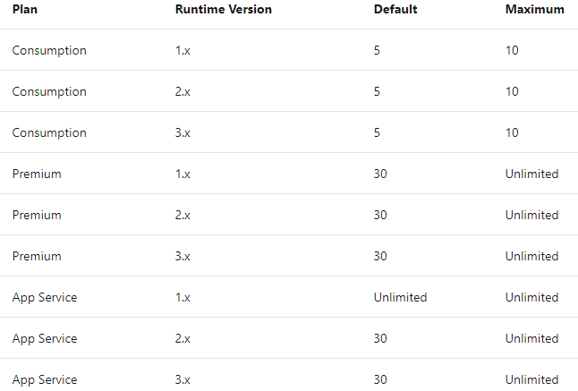
Azure Functions Drawbacks
Function app
timeout duration

Slide 9
Overview of Triggers
A trigger is what invokes a function to run
A trigger defines how a function is invoked
Each function in Azure Functions must have only one trigger
Triggers usually have associated data, which is nothing but the payload that triggerred the function

Slide 10
Triggers: Hands-on

Slide 11
What are Kudu in Function App
The advanced tools for App Service (also known as Kudu)
Provide access to advanced administrative features of your function app.
From Kudu, you manage
System information,
App settings,
Environment variables,
Site extensions,
HTTP headers, and
server variables.
Accessing your KUDU console is easily done via the following URL: https://dotest.scm.azurewebsites.net
Replace dotest with the name of your app name

Slide 12
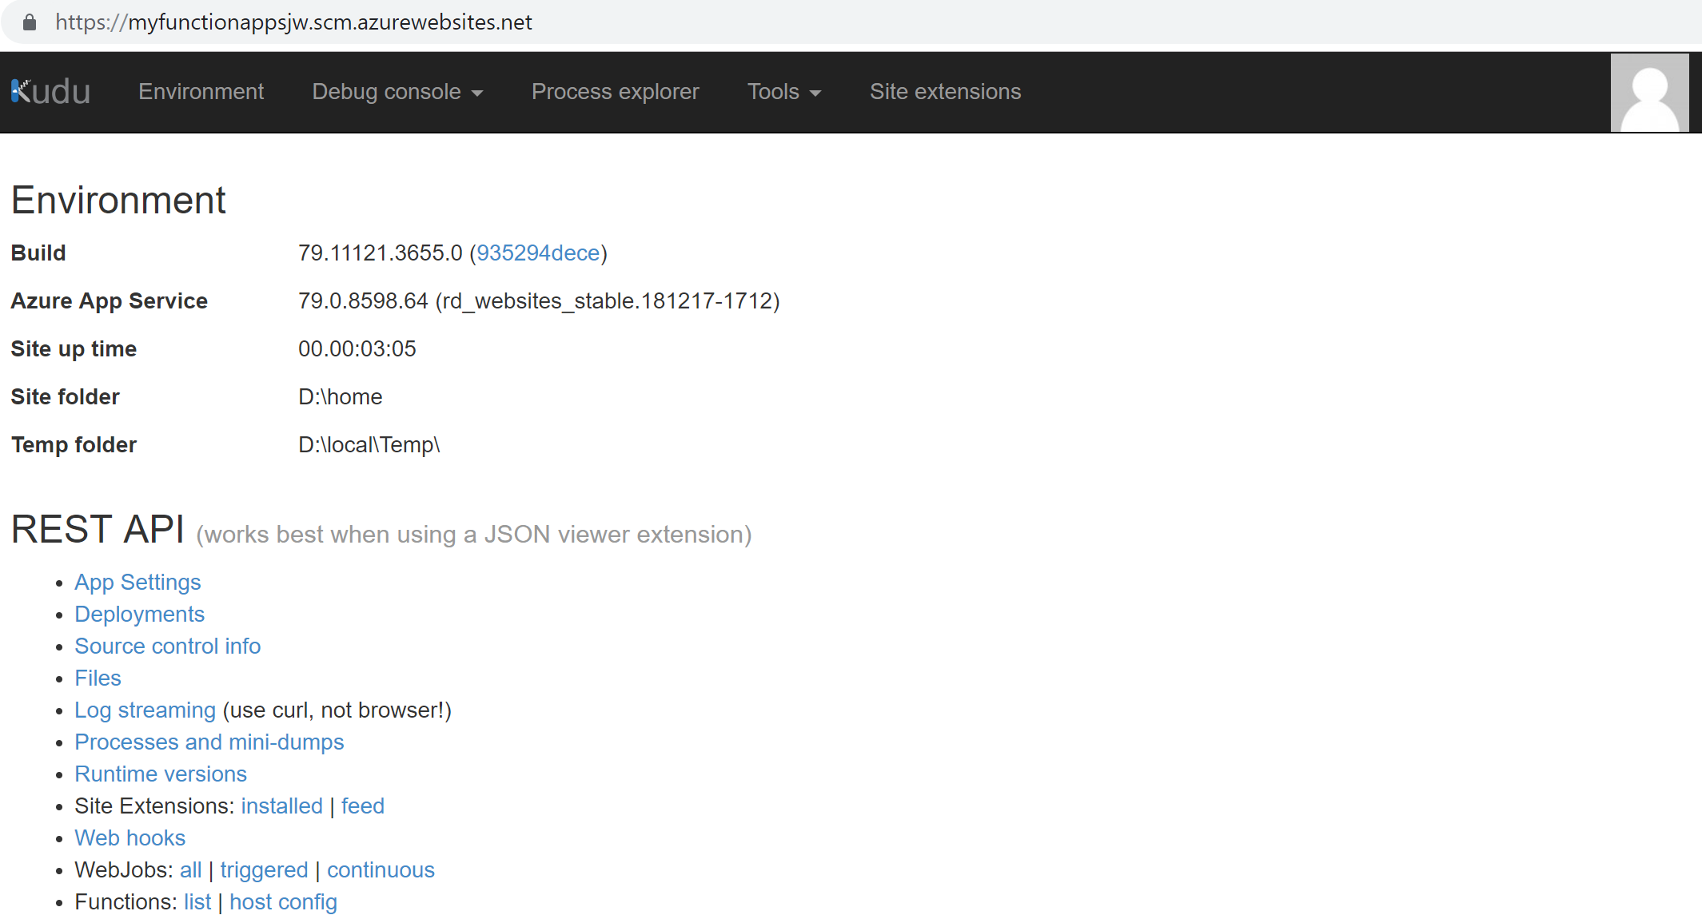
What are Kudu in Function App

Slide 13
Kudo: Hands-on

Slide 14


